Slide 1
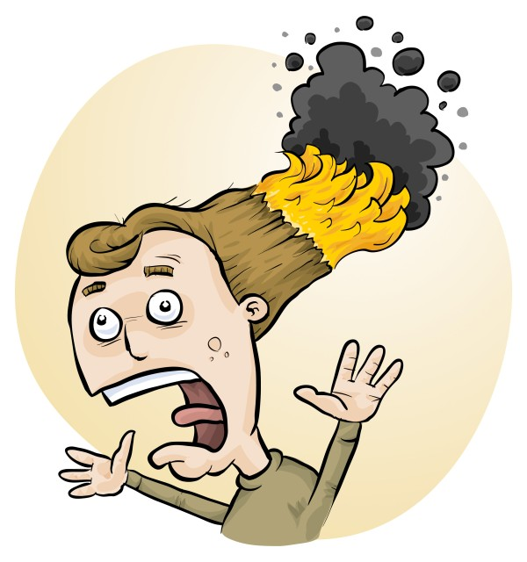
RiskAssess: For new and experienced users
James, Phillip and Eva Crisp

Slide 2
• reduce injuries • increase legal protection
Why do risk assessments?

Slide 3
Issues
facilities available
behaviour of the class
students with special needs
students with allergies
. . . . . . . .
Issues may, and commonly will,
differ from class to class.
No one hat fits all!

Slide 4
THE LAW? Work Health & Safety Act
. . . a duty . . . to eliminate/minimise risks to health and safety as far as is reasonably practicable.
. . . taking into account and weighing up all relevant matters including: (a) the likelihood of the hazard or the risk concerned occurring; and (b) the degree of harm that might result from the hazard or the risk . . . .
Part 2, Sections 17 and 18
Notes:
NOT book “risk assessment”, tick sheet, etc
likelihood
degree of harm consideration requires
proper risk assessment using a risk matrix
e.g. Aust/ISO Standard on Risk Management

Slide 5
VIC Occupational Health & Safety Act 2004
Persons who control or manage matters that give rise or may give rise to risks to health or safety are responsible for eliminating or reducing those risks so far as is reasonably practicable. [Part 1, Section 4(2)]
WA
Occupational Health & Safety Regulation 1996
A person who, at a workplace, is an employer . . . must, as far as practicable (a) identify each hazard to which a person at the workplace is likely to be exposed, (b) assess the risk of injury or harm to a person resulting from each hazard, if any, identified under paragraph (a), and (c) consider the means by which the risk may be reduced. [Part 3, 3.1(a)-(c)]

Slide 6
What is RiskAssess?
• web-based risk assessment tool
• customised to the school situation
• provides - electronic templates (AU/ISO) - database information on risks (chemical, equipment, biological) - equipment ordering/lab scheduling - labelling (GHS)
- learning resources
• easy sharing of experiment templates for customisation

Slide 7
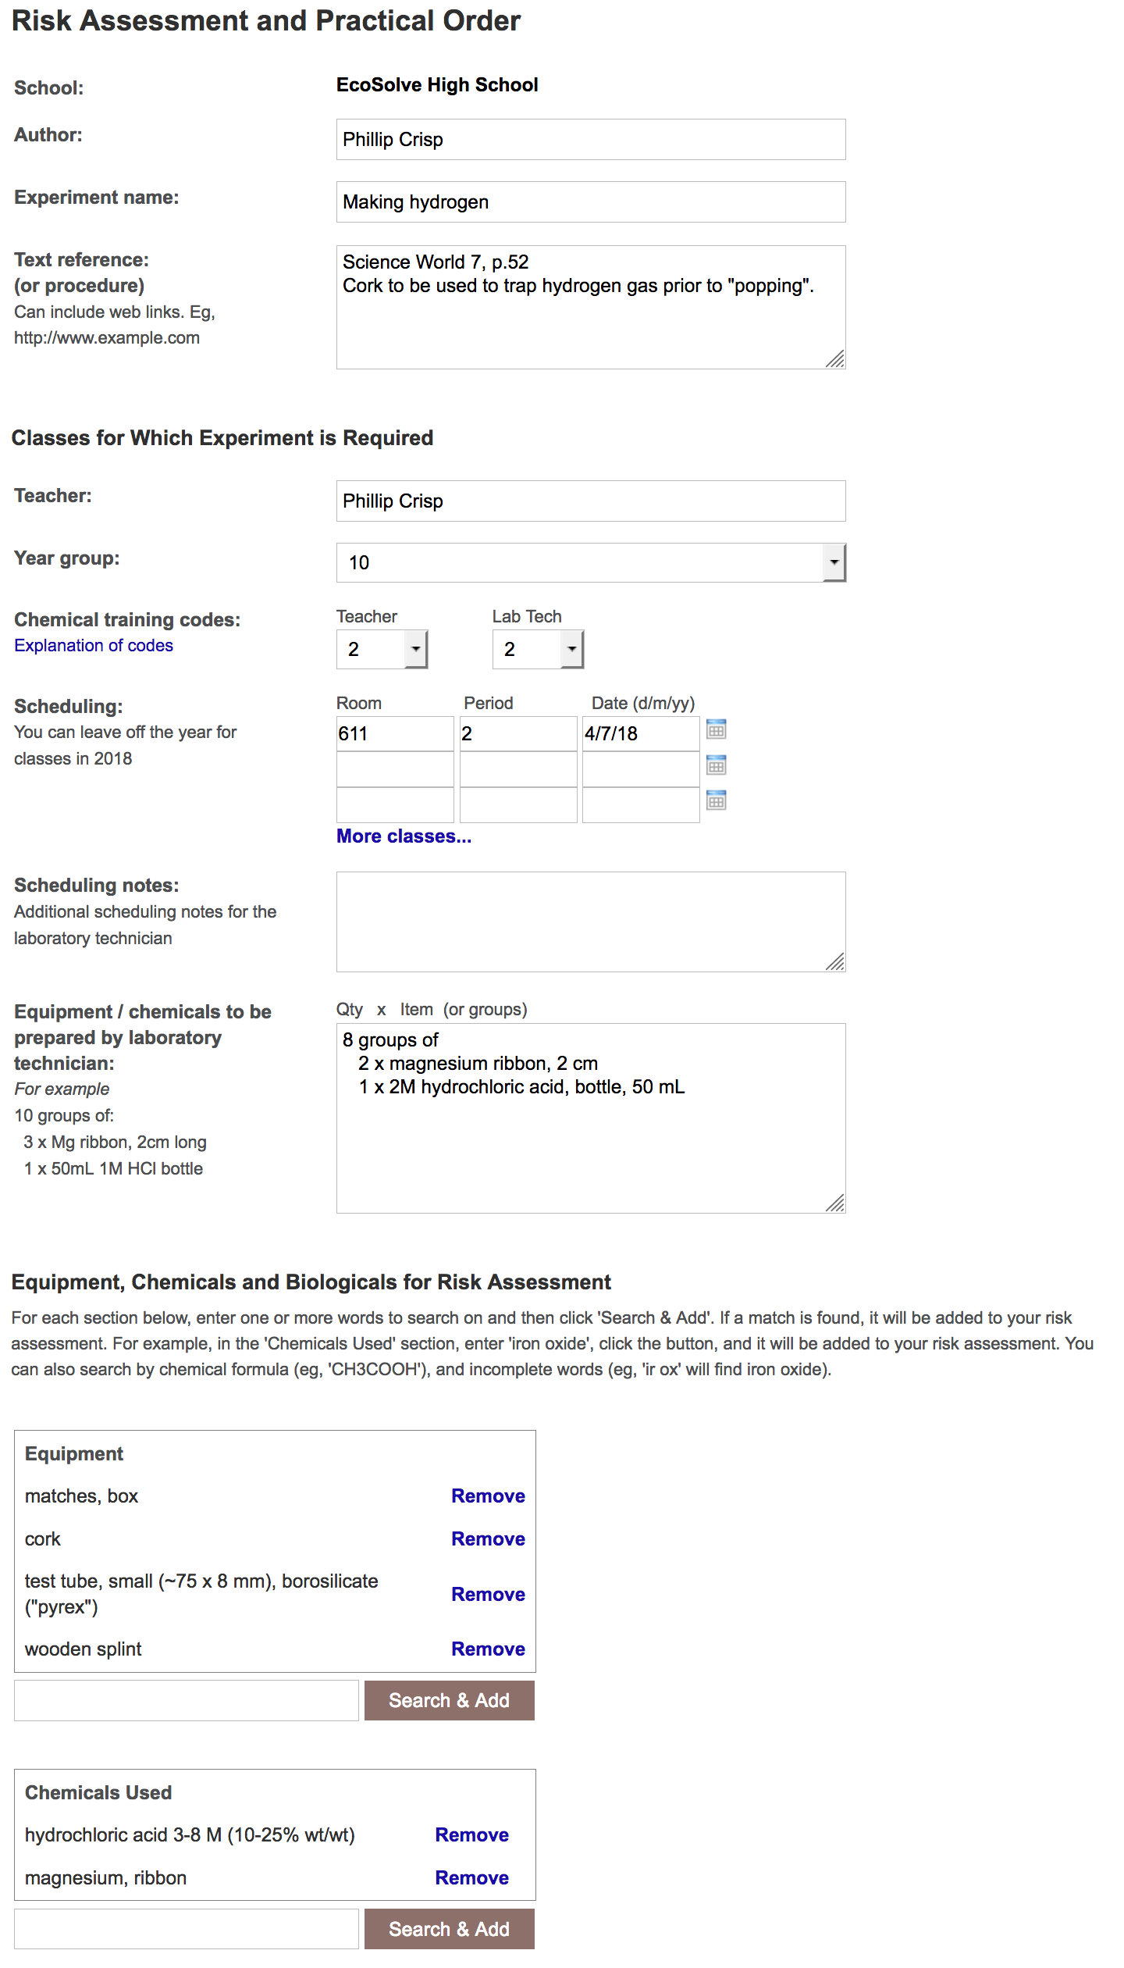
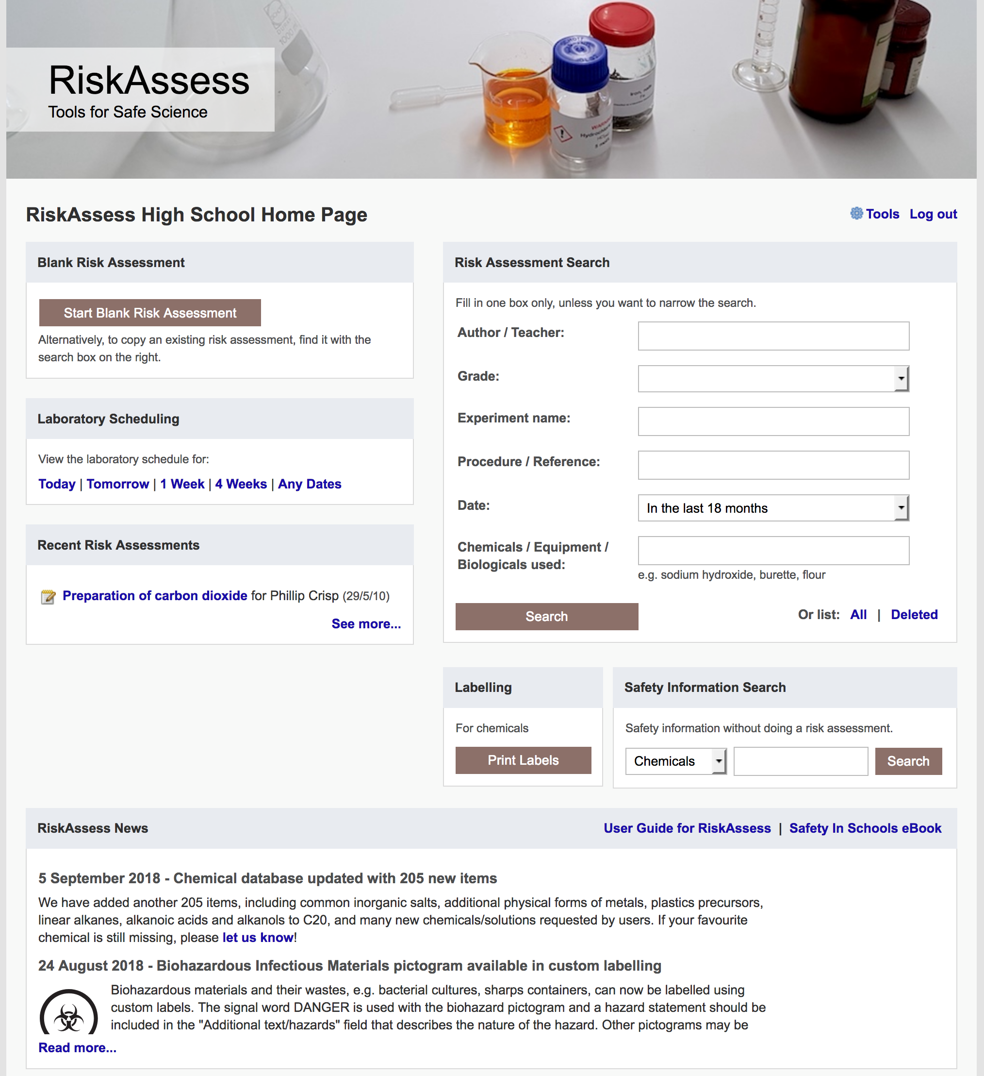

Slide 8
Logic
• separate sections for teacher and laboratory technician
• initial assessment of inherent risk - if low, go to end - if medium or more, record control measures - if high or extreme, third reviewer required
• cross-checking by teacher/labtech/reviewer
• scheduling, ordering, labelling to save time
• inexpensive ($250+GST per campus per year)

Slide 9
Electronic system
• relatively rapid
• prompts sensitive to context
• reduces paper consumption
• easy to review and update
• easy monitoring and statistics
• easy storage
• demonstrated to work in schools RiskAssess: 2074 schools AU+NZ+CA
3,617,000 risk assessments

Slide 10
Details
• access from school/home
• nothing to install on computer, tablet or phone (instant update)
• unlimited number of simultaneous users and risk assessments
• minimal data entry
• complements SDSs
• continuing input from science staff
• multiple backups of data & backup server
• support and advice

Slide 11
Advantages of RiskAssess
• proper consideration of risks and control measures
• standardisation
• storage of records for legal purposes
• communication between teachers and laboratory technicians
• discourages spur-of-the-moment experiments
• useful for new/inexperienced staff

Slide 12
Outcomes
• reduced frequency of injuries - to students - to school staff
• reduced costs for paperwork, litigation and payouts
• compliance with the law
• helps maintain variety of chemicals and equipment
• compliance with the Australian Curriculum

Slide 13
High schools AU 1853 (68%) VIC: 503 (87%)
471 high schools VIC: 128 (22%)
189 primary schools

Slide 14
Shortcuts and ease
login, hcl, part name, click banner
links, hot links, Biological&Food
database additions
Scheduling
download csv (for any dates)
high & extreme risk
author update/modifiable copy
Tools
customise year groups
stocktaking & usage, TI,
link RA and SRA
Learning resources
Getting Started Video
Q&A, eBook
Disposal of chemicals
generic advice
individual chemical advice
Labels
standard & custom labels
commercial products (others)
mixtures, non-chemicals
free text, biohazard pictogram
Operations
reschedule experiments, delete
archive risk assessments, icons
labtech-only RAs, annual review
3rd reviewer, backup
bulk RA download
Student RiskAssess
view student PINs, not last year

