Slide 1
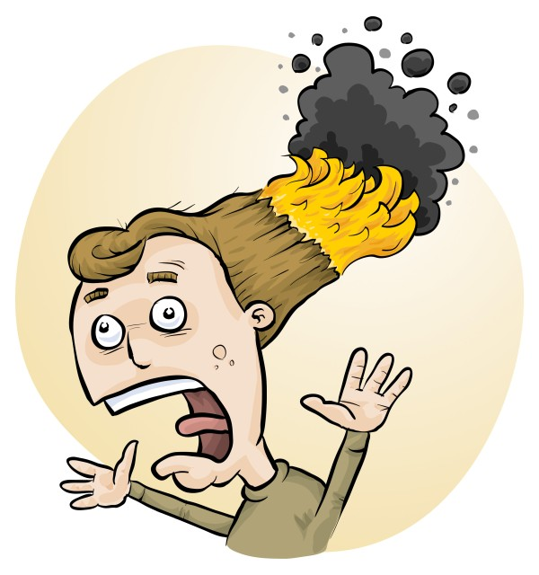
RiskAssess: new features, tips and tricks
Phillip Crisp and Eva Crisp

Slide 2
2700 schools AU: 2400 (84%) NZ: 300 (54%) CA: 60 (1%)
580 schools
200 schools
80 schools

Slide 3
New Features

Slide 4
Notes:
Mandatory setting too in tools! Settable cut-off time coming soon (other than noon)

Slide 5
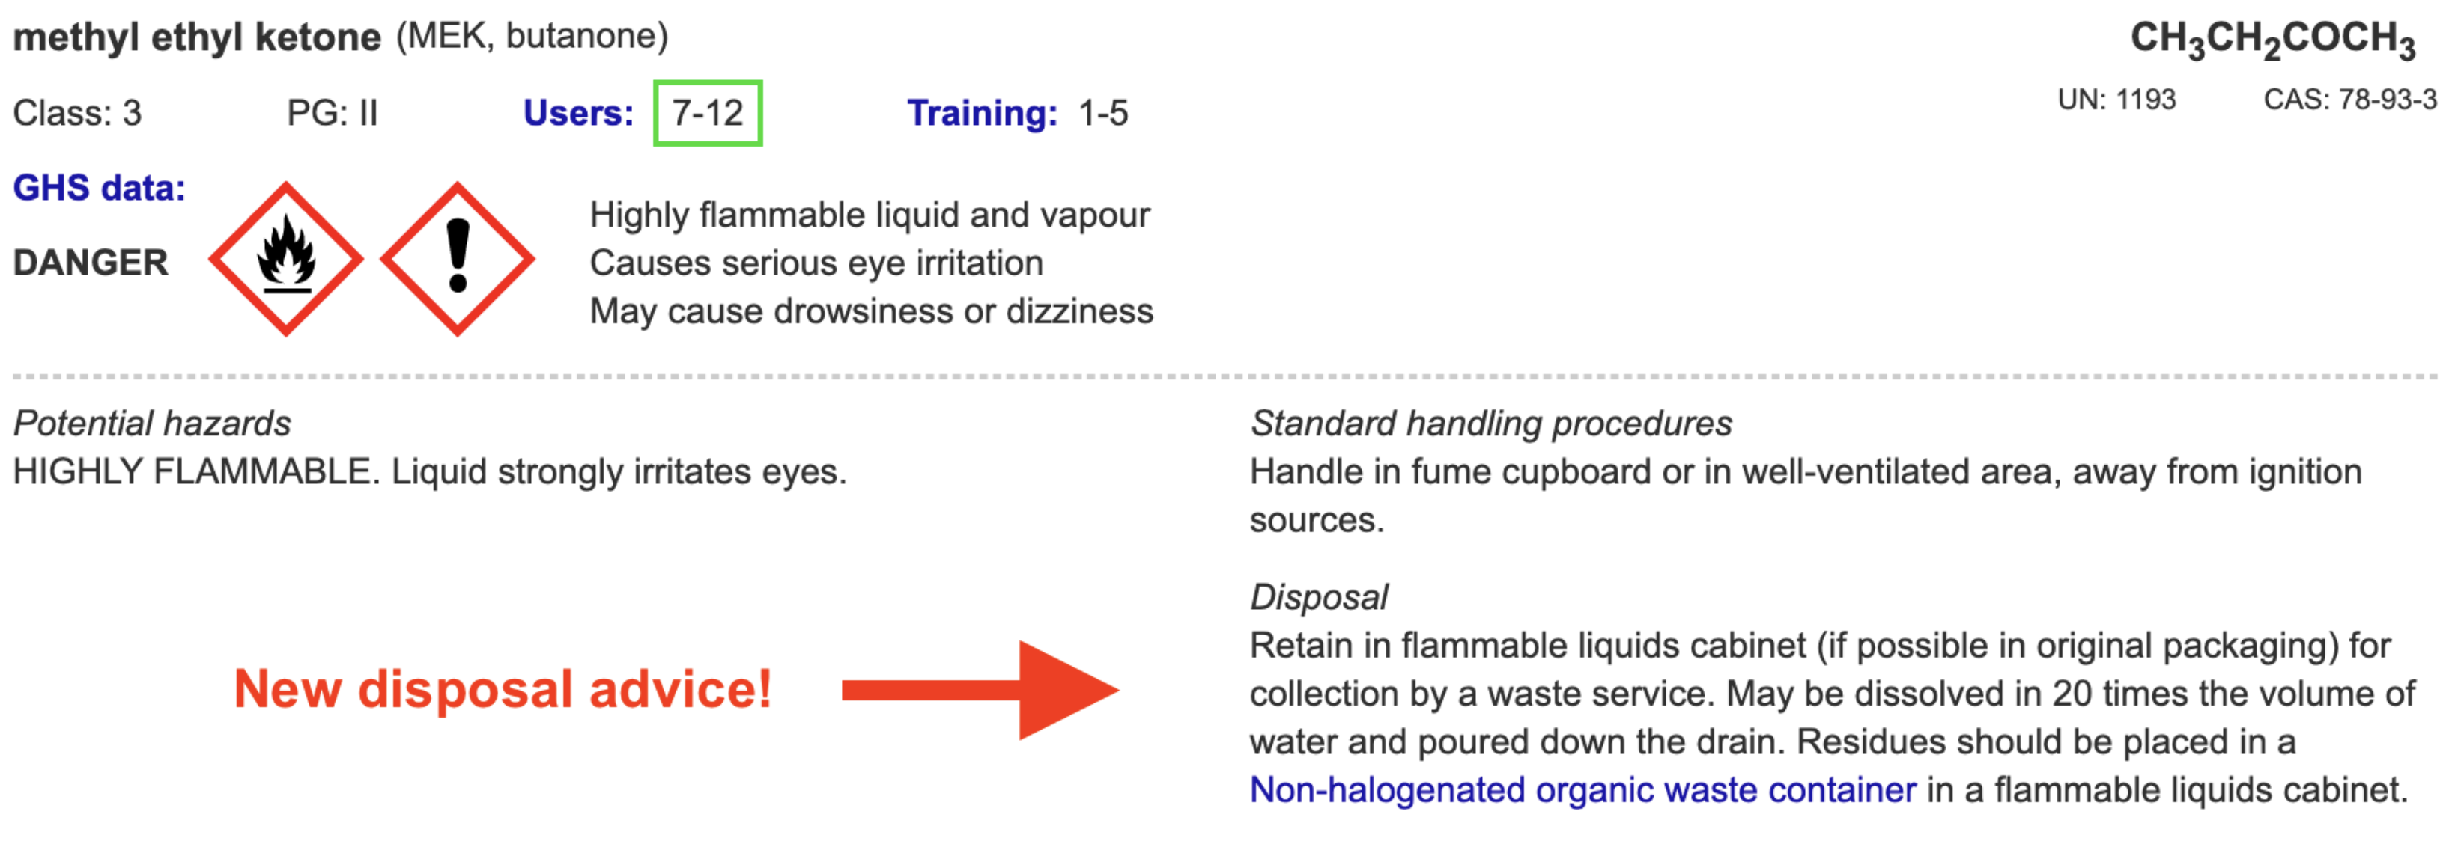
Disposal
Advice for all 3100 chemicals and solutions
Guide to disposal and waste container details
NEW Waste container labels!
Notes:
Requested at ASET last year

Slide 6
Safety Databases
>650
new and updated items!
Especially expanded coverage of
+ saturated solutions
+ test papers & reaction products
+ geological minerals and rocks

Slide 7
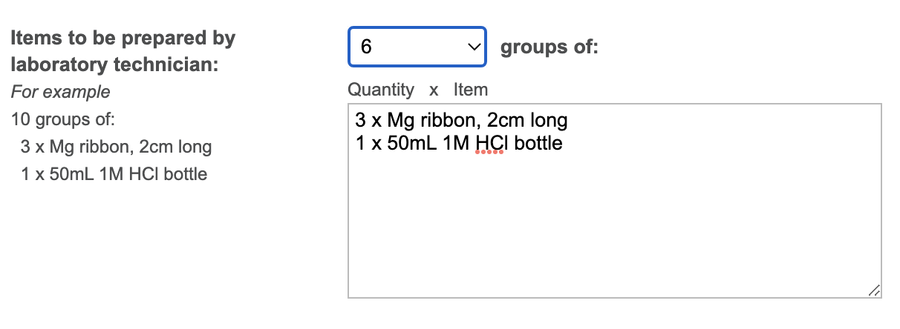
Notes:
Mandatory setting too in tools!

Slide 8
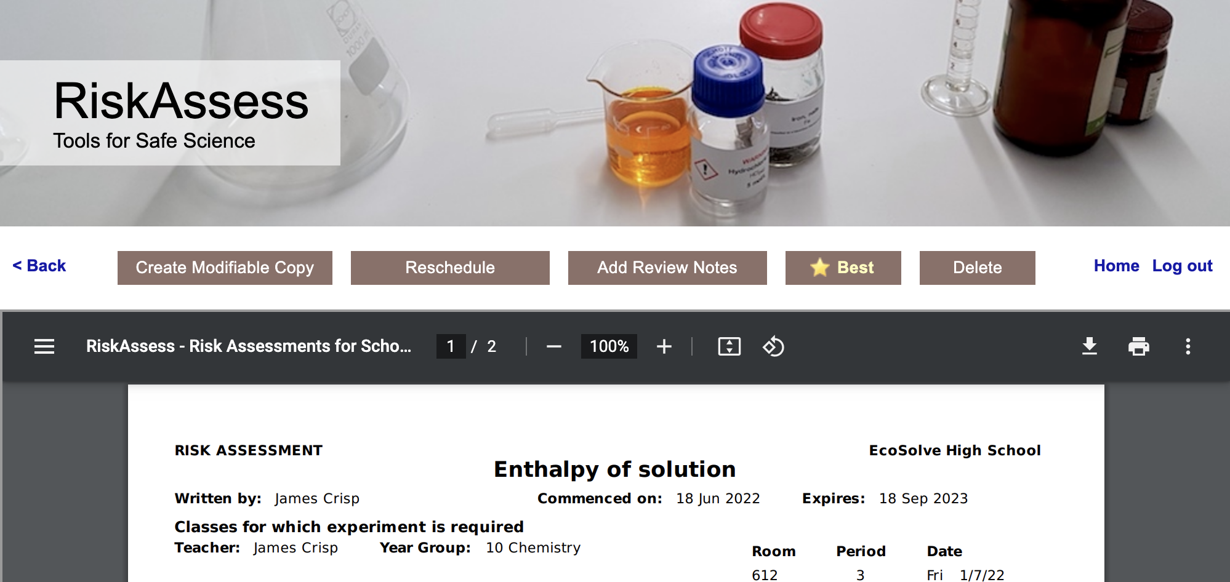
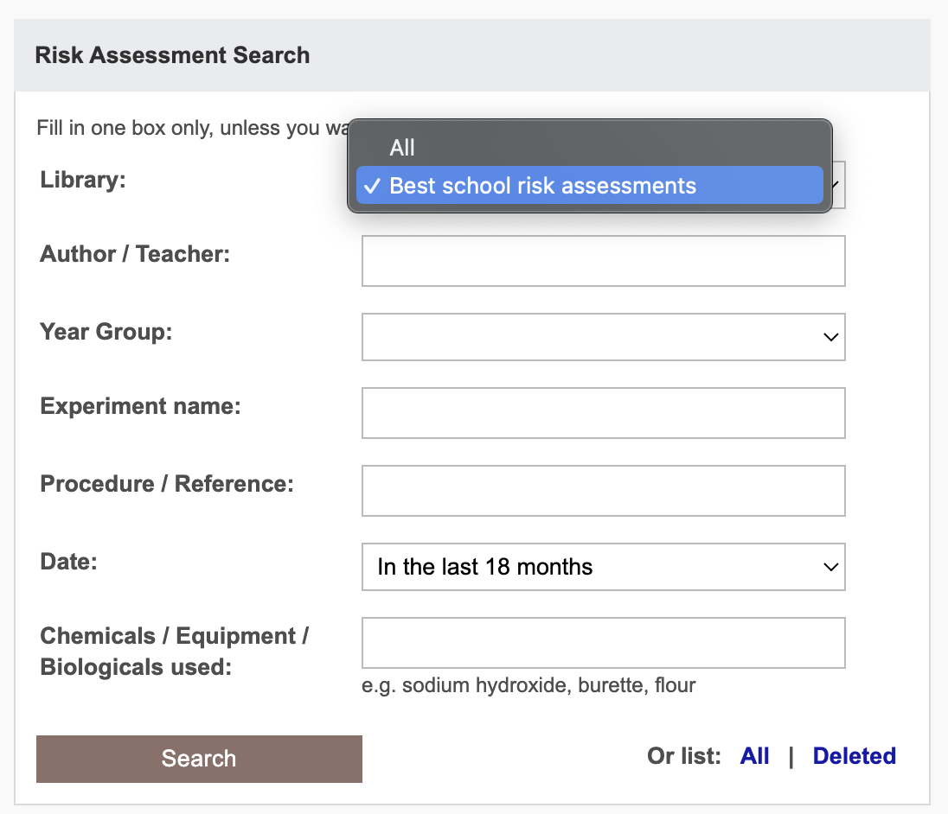

Slide 9
Future developments
• continually adding new features https://www.riskassess.ca/info/news e.g. more chemicals, updated learning resources
• planned: - chemical register/inventory - SDS management system

Slide 10
Tips & Tricks

Slide 11
Menu
Shortcuts
icons, hcl, part name, search on less,
click banner, links, hot links, delete,
# & sort, Best RAs
Scheduling
Excel/csv, any dates, last week,
search, no# pracs, prep notes,
double booking, lodged date/time
Tools
invoice, customise year groups,
backups, stocktaking & usage,
defaults
Resources
learning resources, faq, eBook,
videos, news
Labels
Standard, custom & waste labels
multiple chemicals on sheet
mixtures, non-chemicals
free text, biohazard symbol
Operations
reschedule, archive, review notes,
annual review, tech-only RAs,
high/extreme: 3 signatures
Multiple classes
author update/modifiable copy
Student RiskAssess
view student PINs, not last year
multiple prac management

Slide 13
Workplace labels
Required “when a hazardous product is decanted
(e.g. transferred or poured) into another container”
and it is not “going to be used immediately”
In general, a workplace label will require the following information:
• Product name (matching the SDS product name)
• Safe handling precautions, may include pictograms or
other supplier label information
• A reference to the SDS (if available)
Workplace label requirements fall under your Provincial or Territorial jurisdiction . . .
Canadian Centre for Occupational Health and Safety “WHMIS 2015 - Labels” https://www.ccohs.ca/oshanswers/chemicals/whmis_ghs/labels.html

Slide 14
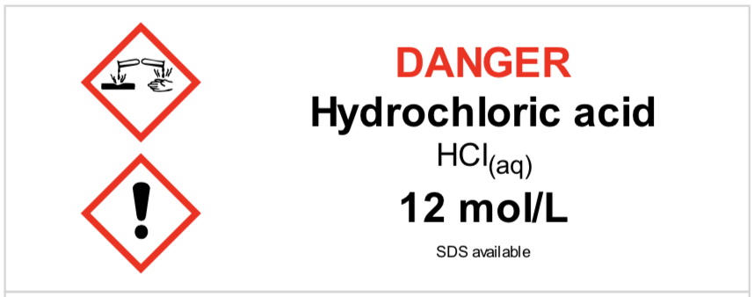
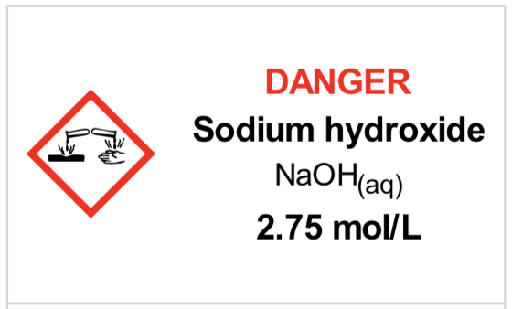
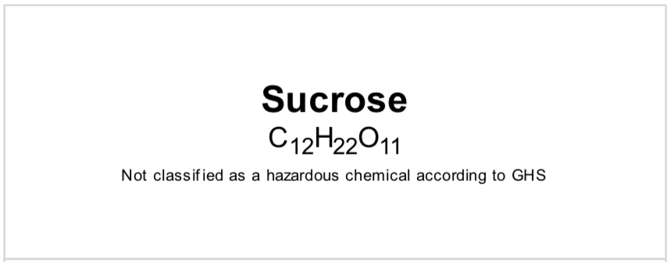
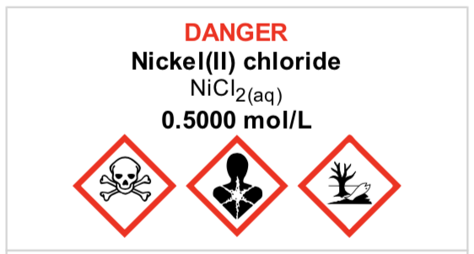
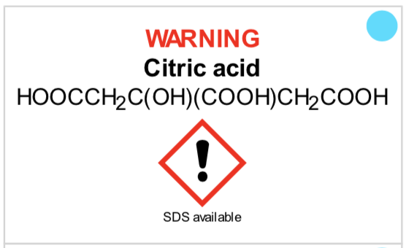
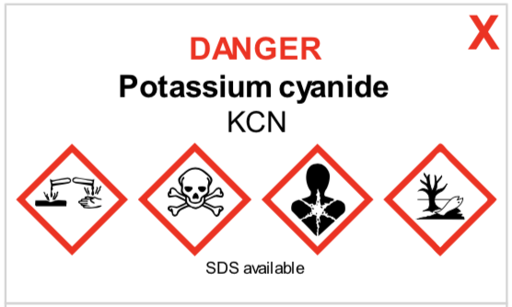
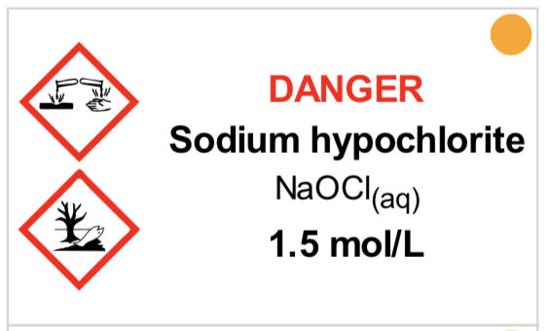
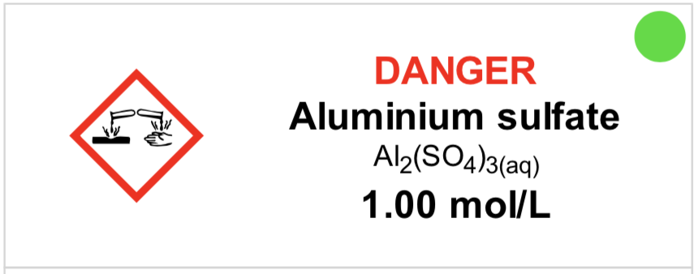
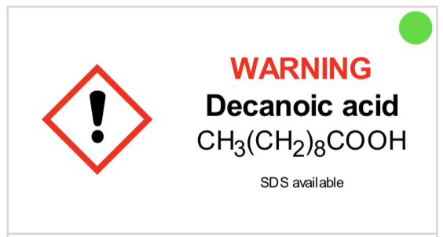
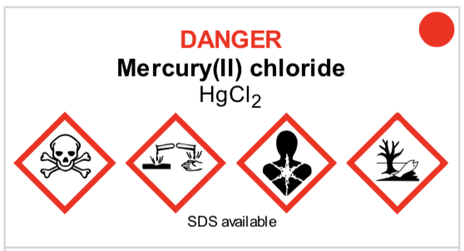
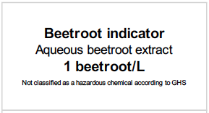
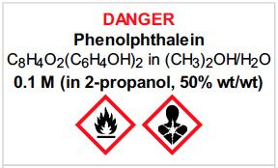

Slide 15
RiskAssess data source
ECHA (European Chemicals Association)
http://echa.europa.eu/information-on-chemicals/cl-inventory-database
Classification and Labelling (CL) Inventory
• notifications by chemical companies in Europe of classifications according to GHS criteria
• harmonised classifications
Provides latest information on classification and labelling.
Some solution information.
Clumsy to use, due to need to translate codes.
Notes:
If needed for question time.

Slide 16
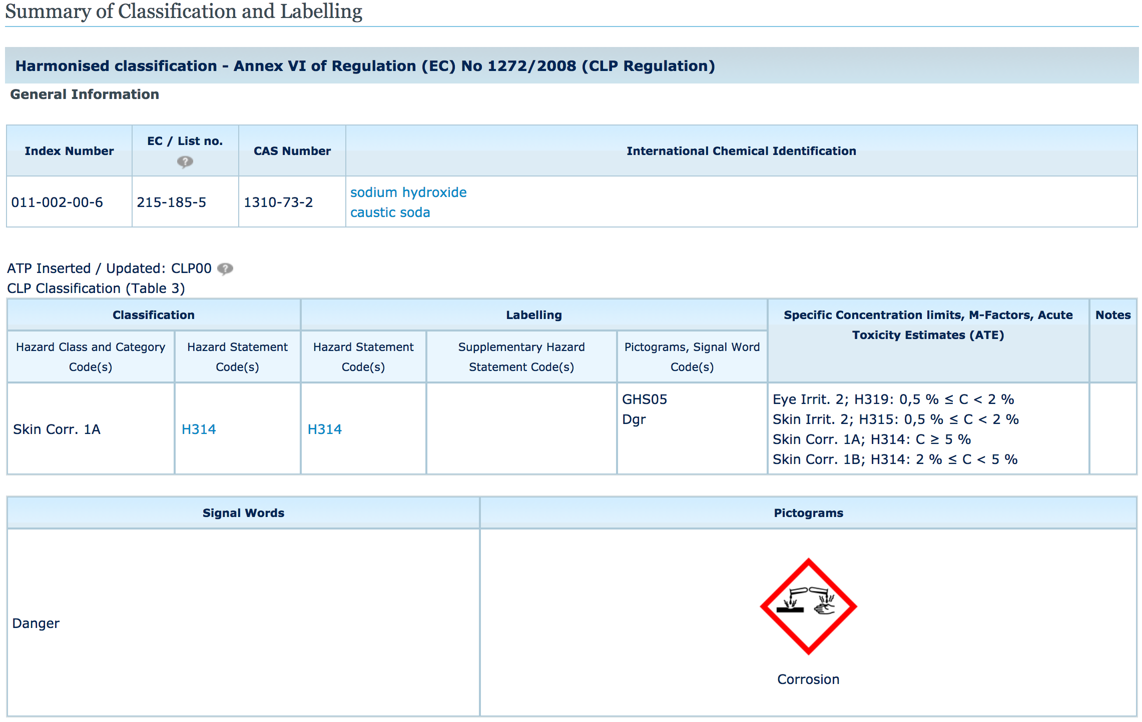
H314: Causes severe skin burns and eye damage
Notes:
If needed for question time.

Slide 17
RiskAssess data
Pure chemicals (>1500)
ECHA data “Harmonised classification”, if available
If not, most common classification (more conservative, if two)
Solutions (>1600)
ECHA data “Specific concentration limits”, if available.
If not, application of GHS rules for mixtures to ECHA data for pure chemical
RiskAssess data are updated as ECHA updates
Notes:
If needed for question time.

